Slide 1
You stay classy…while identifying project utility facilities
Veronica Corningstone - KYTC
Ron Burgundy – AECOM
Brian Fantana - GRW

Slide 2
You Stay Classy, KYTC

Slide 3
Utility Impacts to Projects
How many of you have had projects affected by utilities?
How many of you have had projects delayed because of utilities?
How many of you have dealt with R/W issues from utilities?
How many people like utilities?

Slide 4
What are the most time consuming items to get a project to letting?
Watching Movies?
Design?
Right of Way?
Utilities?
Getting weather forecast from Brick?
What about utility impacts to R/W?

Slide 5
Preliminary Utility Coordination
Involve Utilities Prior to Joint Inspection
Joint Utility Meeting
Critical Conflicts
Easement Needs
Avoidance Possibilities
Relocation Placement
Phasing and Scheduling
SUE Needs

Slide 6
5-367.20 Extension Old Henry Road to Ash Avenue
KY 362
Jefferson/Oldham County, KY

Slide 7
KY 3084 SCOPE OF WORK
Final Roadway Design Plans
Utility Coordination
Ron is a fake
60% Water Relocation Plans
Final Sanitary Sewer Relocation Plans

Slide 8
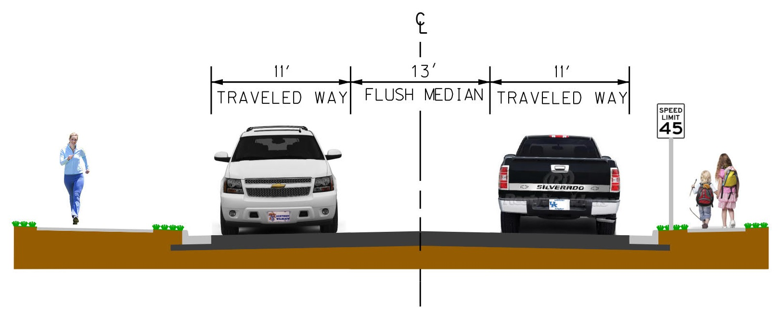
5-367.20 KY 3084 project location
Jefferson/Oldham Counties
Jefferson County 1.53 Miles
Oldham County 0.32 Miles
Total Project Length ~ 1.85 Miles (doesn’t include approach roads)
Typical Section

Slide 9
5-367.20 KY 3084 impacted utilities
Preliminary Utility Conflicts Identified:
LG&E/KU (Electric and Gas)
Spectrum (Cable)
MSD (Sanitary Sewer)
AT&T (Fiber/Telephone)
Louisville Water Company (LWC)
Oldham County Water District

Slide 10
5-367.20 KY 3084 design aspects
Field verified survey/topo was correct with all existing facilities
Finalized horizontal and vertical alignments
Sent plans to each utility company for verification
Cut/Fill Areas
Let’s Meet…

Slide 11
MEETING SUMMARY
What did we do exactly?
9-9-13 ~ Project Team Meeting
2-20-14 ~ Pre-Joint Inspection Utility Meeting
4-14-14 Drainage/Joint Inspection
6-26-14 ~ Affected Property Owners Meeting
8-18-14 ~ R/W Plans Submittal
10-30-14 ~ Joint Utility Meeting
8-14-15 ~ Utility Coordination Meeting
10-29-15 ~ MSD 50% Plans Meeting
4-8-16 ~ LWC 30% Plans Meeting
10-4-17 ~ Utility Coordination Meeting

Slide 12
WHY HAVE ALL THOSE MEETINGS?
Identify impacts for each utility as early as possible
Cut/fill areas
Provide adequate PE and/or Prop R/W to accommodate relocations
Avoid R/W Revisions
Keep project on schedule/budget
Allow utility companies to schedule/budget relocations

Slide 13
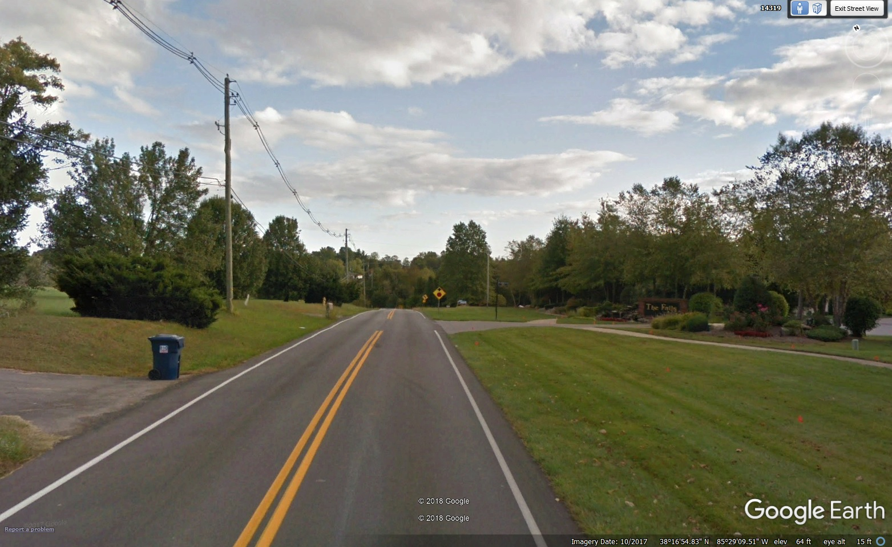
5-367.20 KY 3084 plan examples
Sta. 1040+00

Slide 14
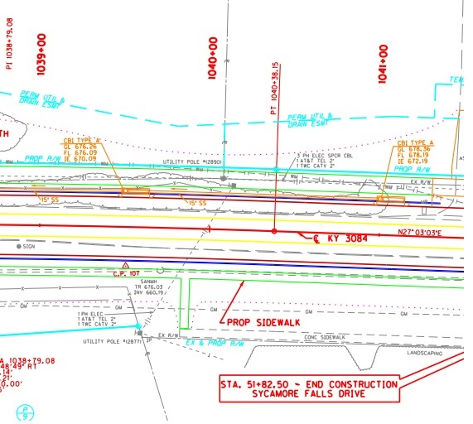
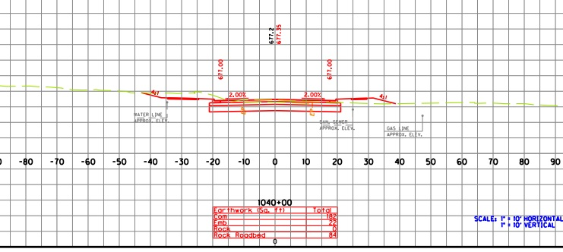
5-367.20 KY 3084 plan examples

Slide 15
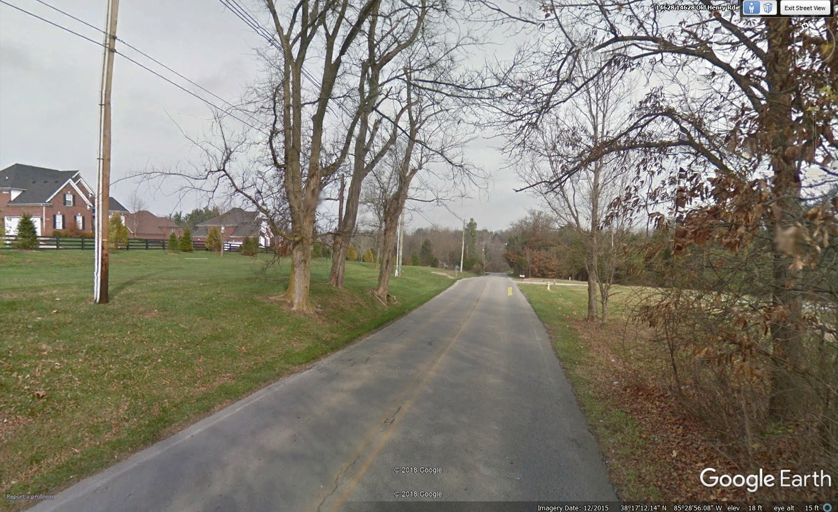
5-367.20 KY 3084 plan examples
Sta. 1065+00

Slide 16
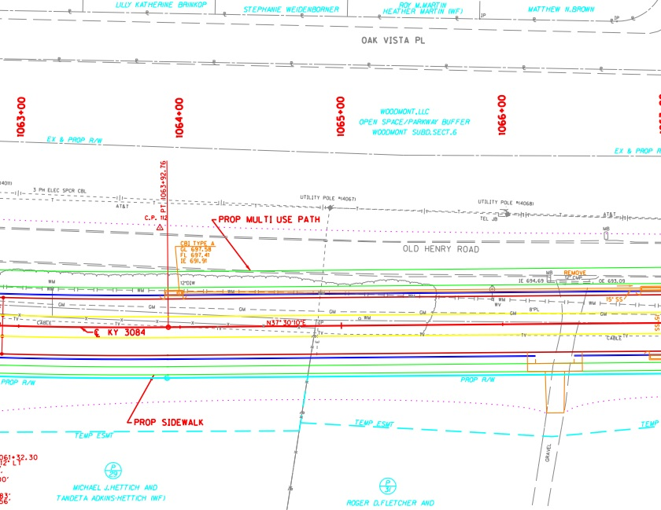
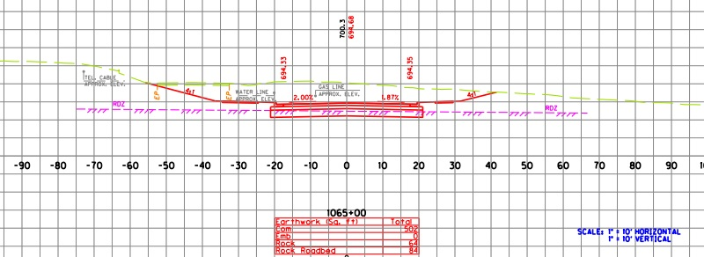
5-367.20 KY 3084 plan examples

Slide 17
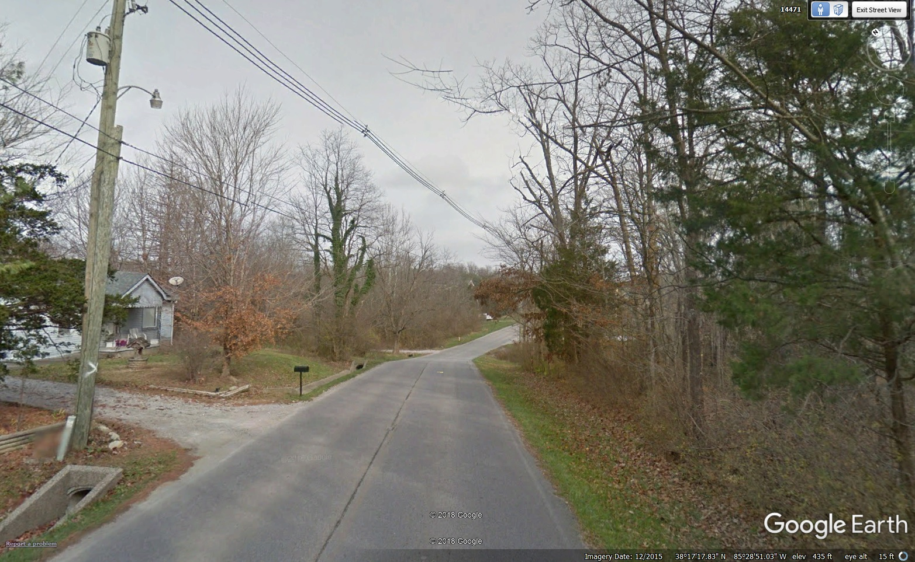
5-367.20 KY 3084 plan examples
Sta. 1071+00

Slide 18
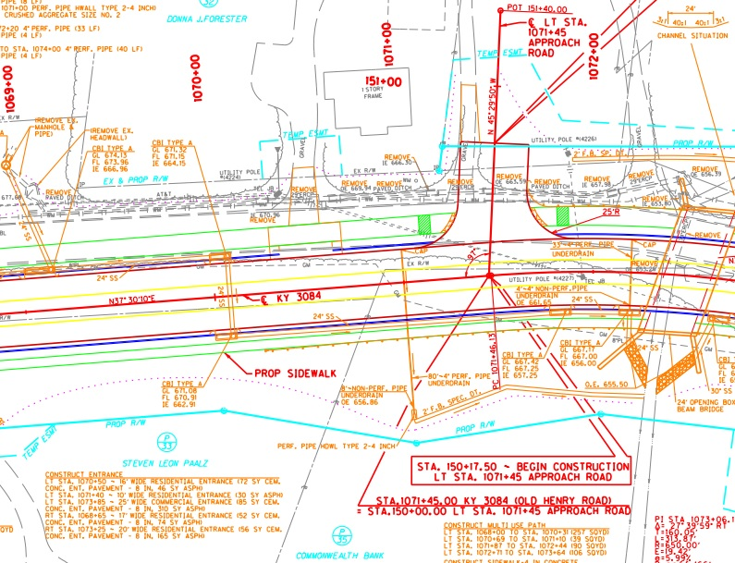
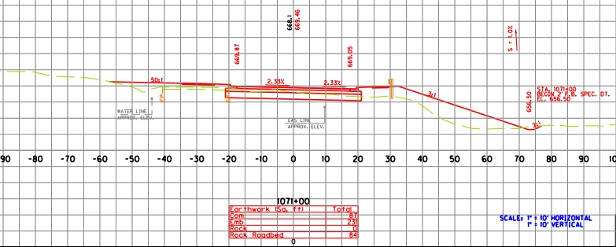
5-367.20 KY 3084 plan examples

Slide 19
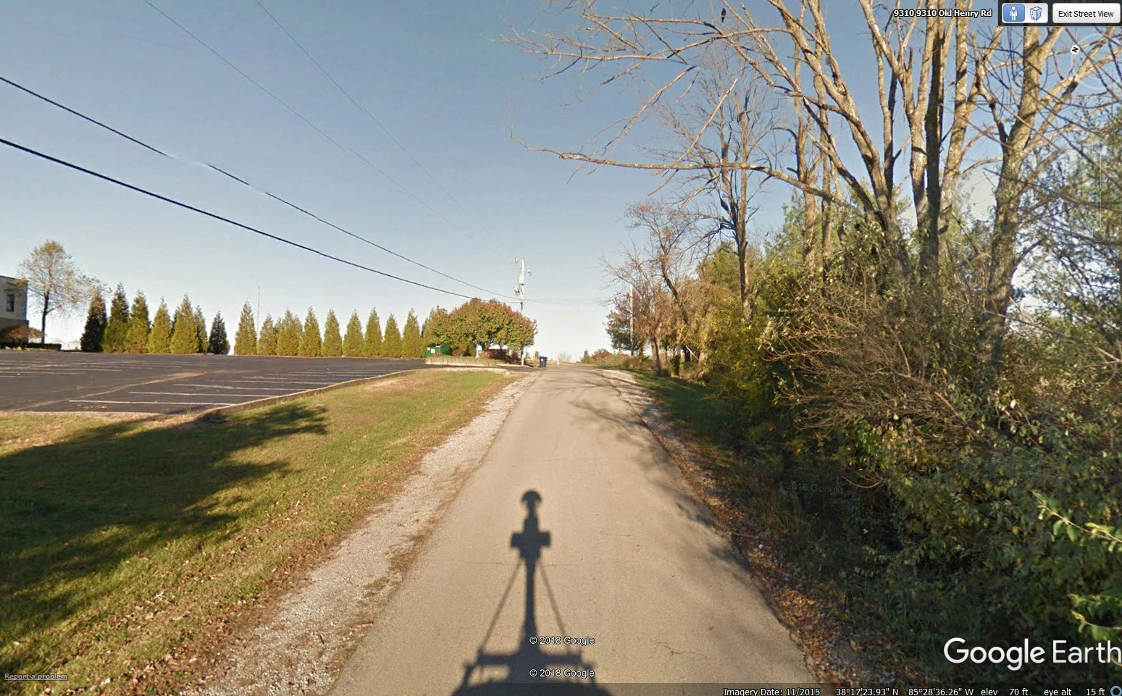
5-367.20 KY 3084 plan examples
Sta. 1083+00

Slide 20
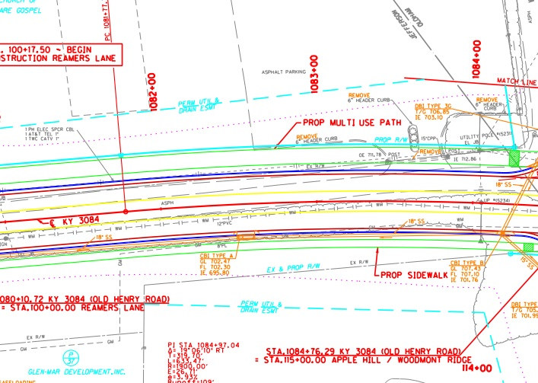
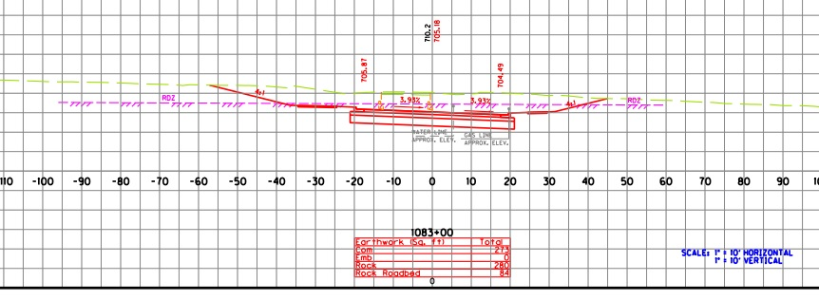
5-367.20 KY 3084 plan examples

Slide 21
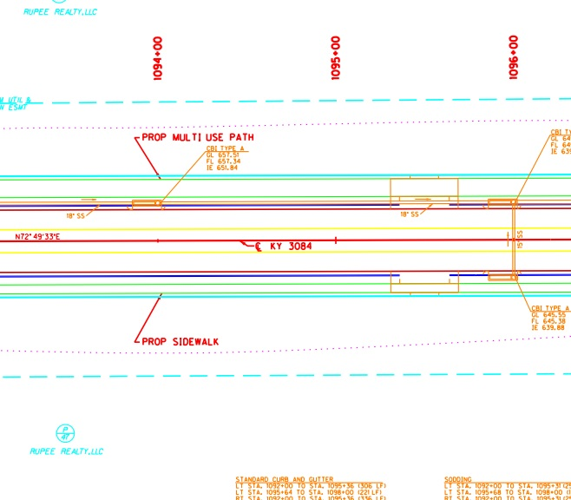
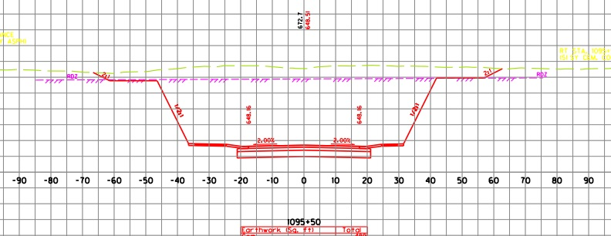
5-367.20 KY 3084 plan examples

Slide 22
5-481.0 Widen Beulah Church Road
KY 864
Jefferson County, KY

Slide 23
Utility Relocation Design
GRW was contracted to developed 60% plans (horizontal and vertical location) for LWC and MSD and 30% plans (horizontal location) for LG&E gas and overhead electric
Goals for developing 30 and 60% plans
Where practical, make adjustments to roadway design to accommodate utilities
Provide appropriate right-of-way/easement for utilities
Minimize right-of-way revisions
Avoid acquiring property from affected owners more than once

Slide 24
Preliminary Utility Coordination
KYTC and GRW held three utility coordination meetings prior to Preliminary Line and Grade
Impacted Utilities Included:
Louisville Water Company (LWC)
Louisville-Jefferson County Metropolitan Sewer District (MSD)
Louisville Gas & Electric
AT&T KY
Time Warner Cable (TWC)
Utility companies established relocation preferences and design guidelines for GRW

Slide 25
Utility Relocation Design
Preliminary relocation plans were developed and submitted to LWC, MSD, and LG&E for review.
Each utility provided feedback on preliminary relocation plans during individual meetings with KYTC and GRW.
GRW revised relocation plans based on feedback and submitted the relocation plans with Final Joint Inspection plans.
Relocation Plans were revised an additional time based on the comments from the Final Joint Inspection review and vacuum excavations.
Revised Relocation Plans were submitted to KYTC with the Supplemental Plan Set

Slide 26
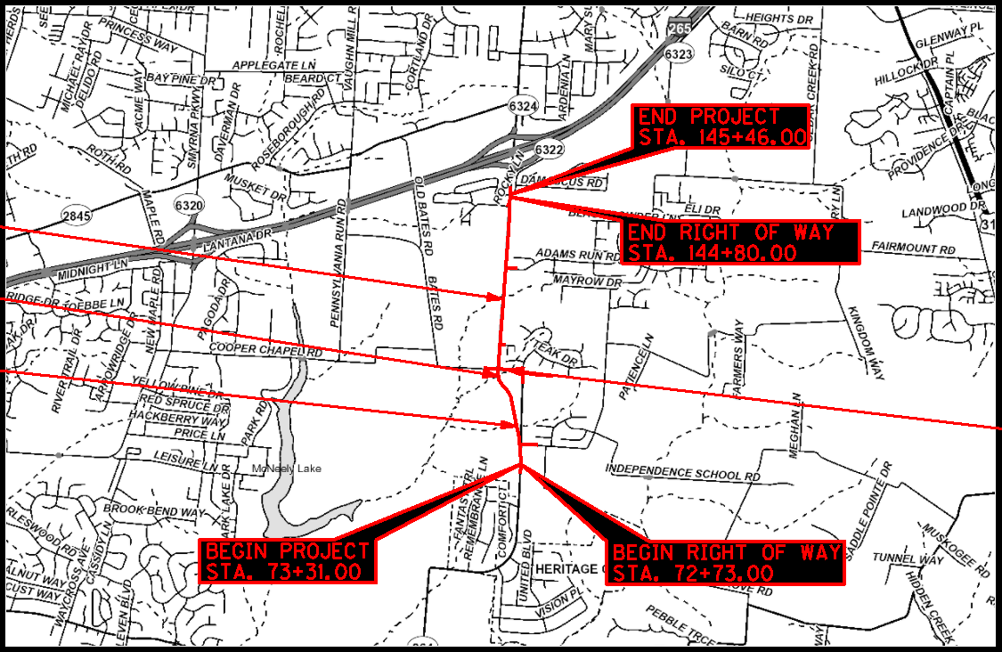
Project Location

Slide 27
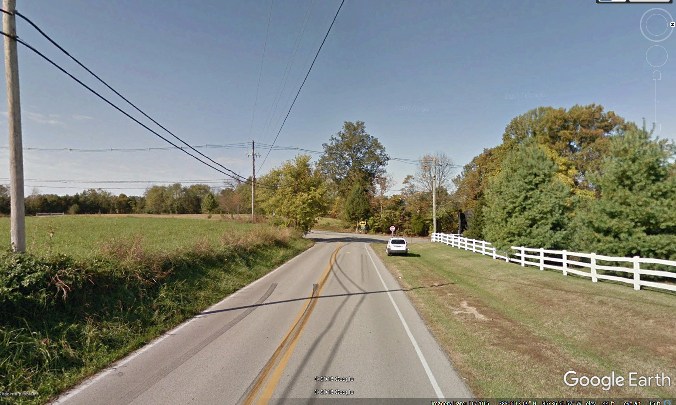
Cedar Creek and Cooper Chapel Road

Slide 28
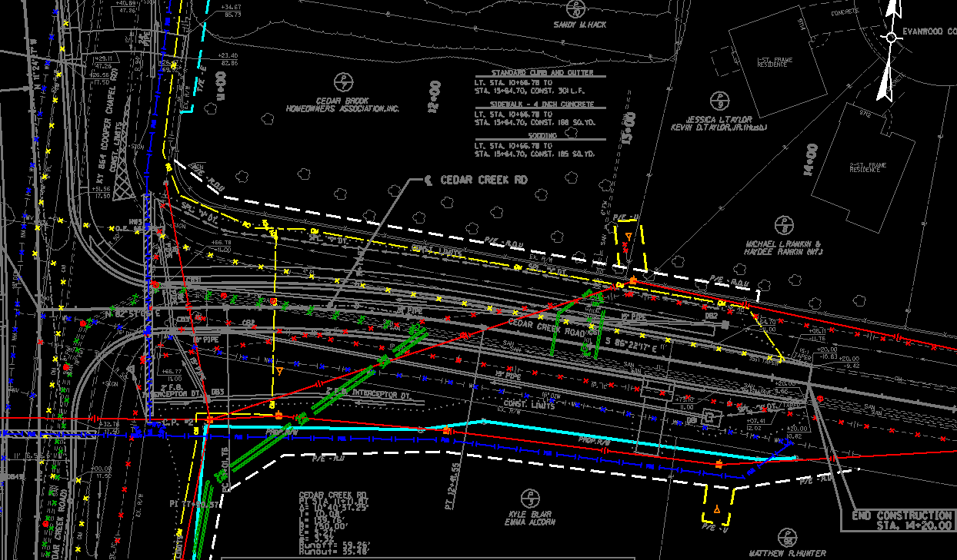
Cedar Creek and Cooper Chapel Road

Slide 29
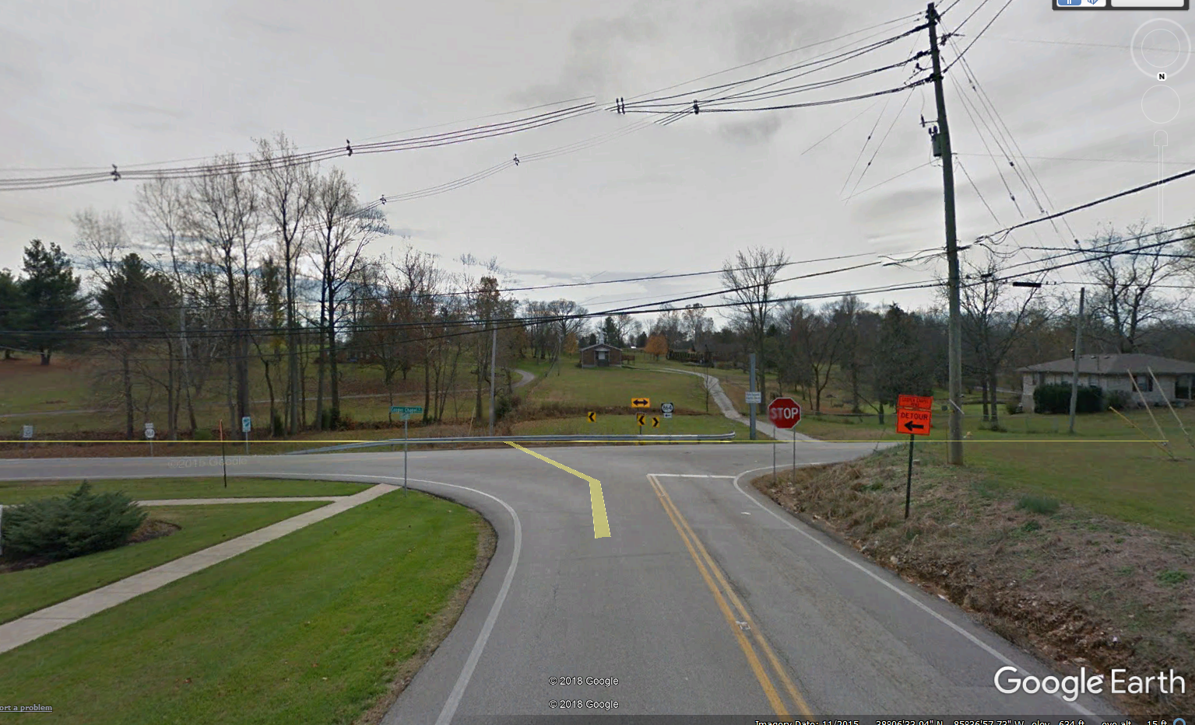
Beulah Church and Cooper Chapel Road

Slide 30
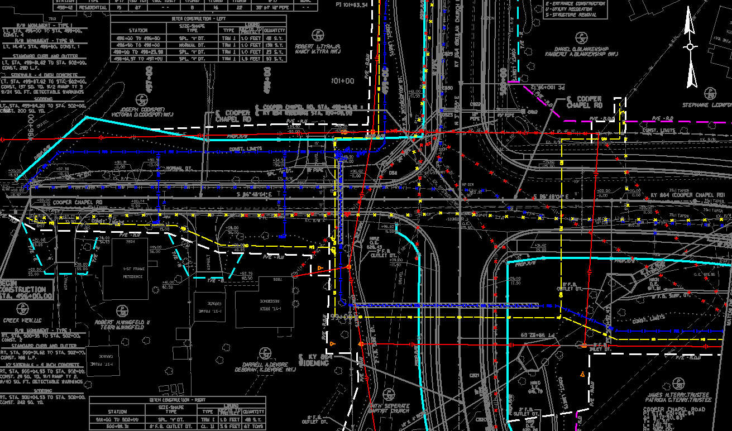
Beulah Church and Cooper Chapel Road

Slide 31
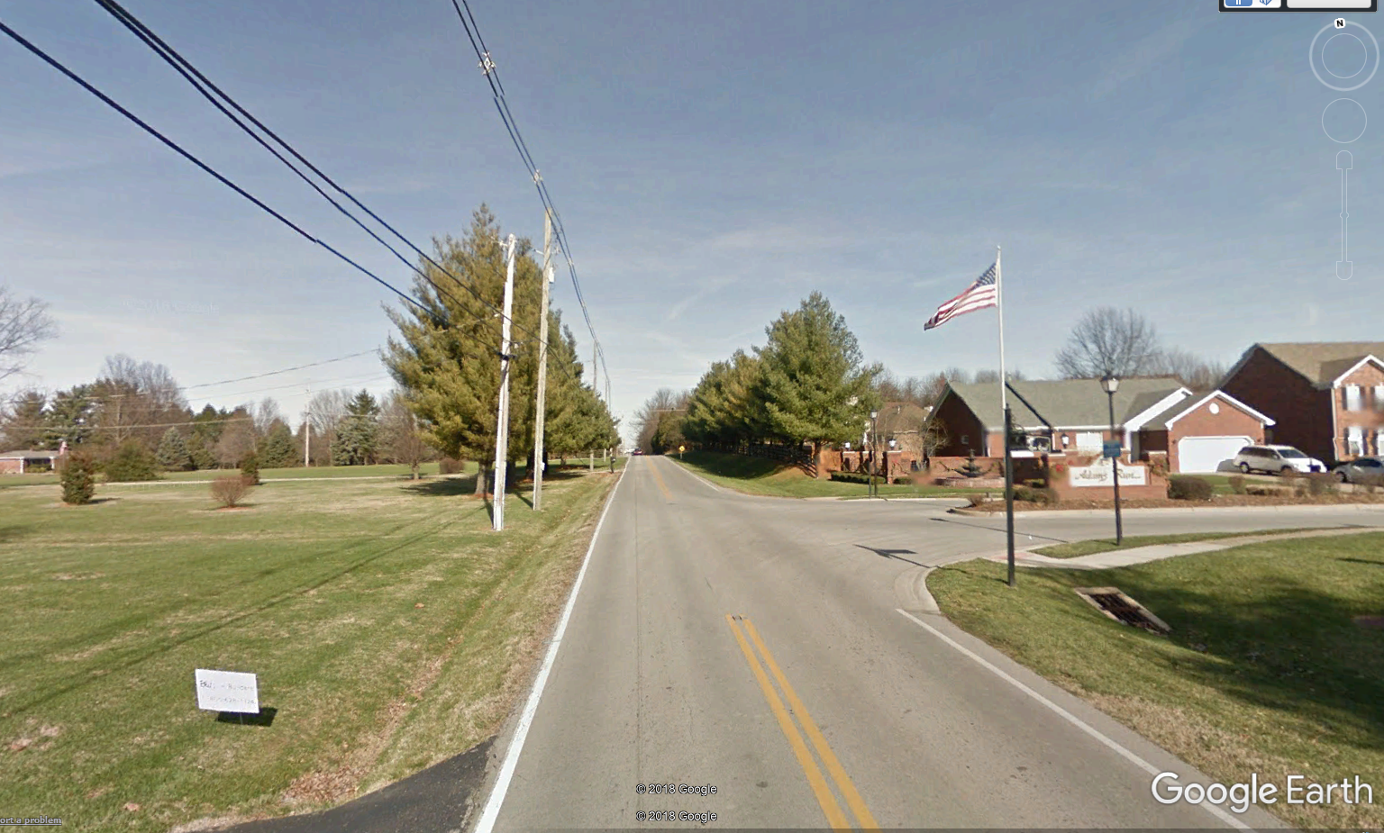
Beulah Church and Adams Run Road

Slide 32
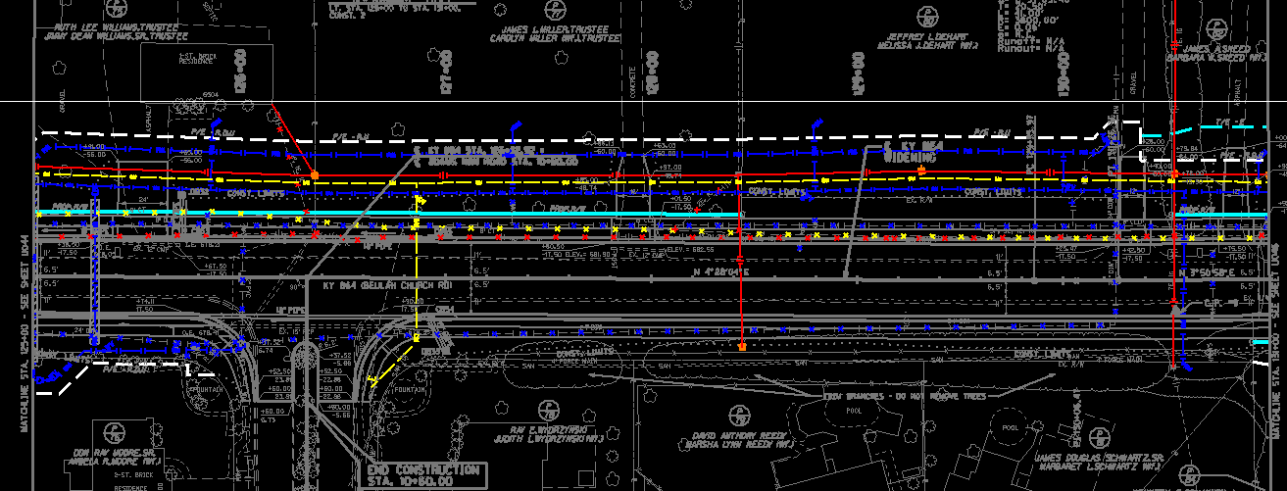
Beulah Church and Adams Run Road

Slide 33
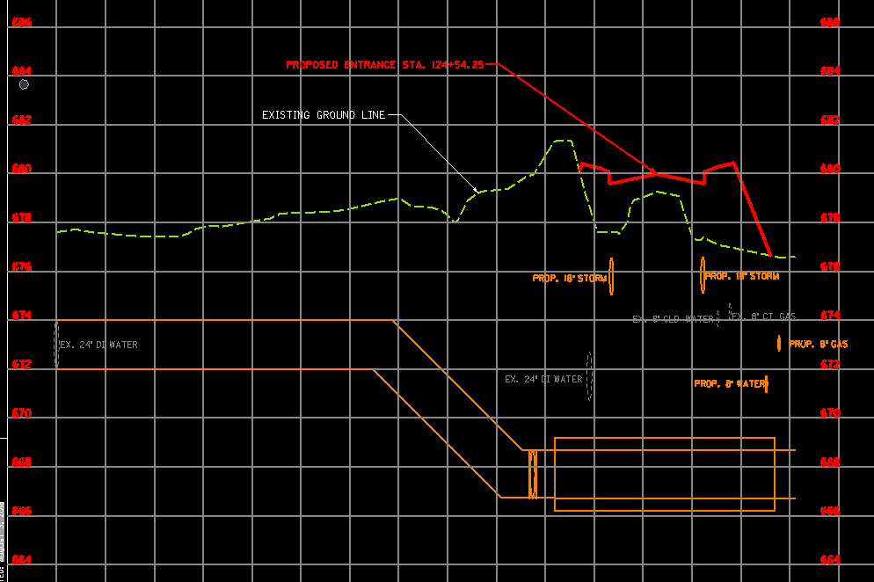
24” Water Main Profile

Slide 34
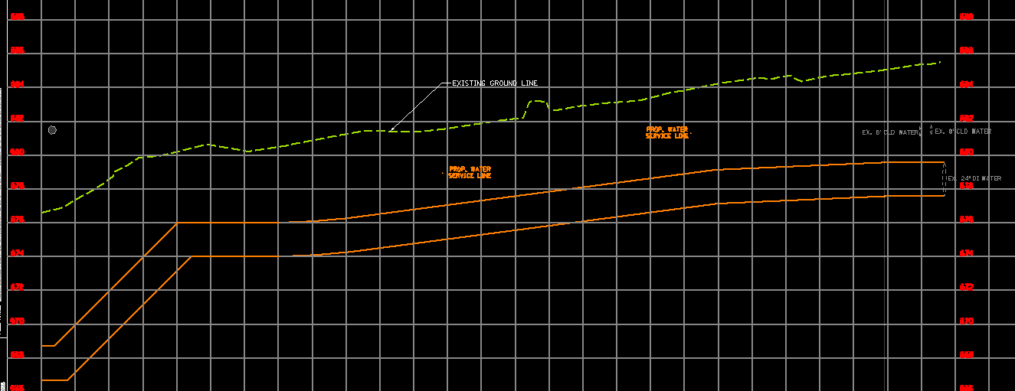
24” Water Main Profile

Slide 35
Conclusions
Involve Utilities Early
Identify adequate R/W and Easement needs
Minimize R/W revisions
Approach property owners once for the project needs

Slide 36
Questions?

Slide 37
You stay classy…while identifying project utility facilities
Caroline Justice- KYTC
Mitch Thomas– AECOM
Nicholas Gunselman- GRW

